Slide 1
NeoTravel Horizons
Case Study: Switzerland Tourism Data (2050–2060)
Brief: Welcome to NeoTravel Horizons. We are the leading strategic consultancy for the 2050s travel market. We have just finalized our decade-forecast for Switzerland. Our team has combined historical data with our proprietary 'Hyper-loop Impact' estimates.
Your mission: Our board of directors needs to see the relationship between the total volume of visitors and the speed of growth.
They won't look at a table—they need a high-integrity Chart that clearly separates what we know from what we predict.
Plot suggestion: Column, line

Slide 2
*commas for EU version
NeoTravel Horizons
Case Study: Switzerland Tourism Data (2050–2060)
Year | Total Visitors [in millions] | % Change YOY[percentage] | Data Status
2050 | 12,4 | — | Actual
2051 | 12,9 | 4,0% | Actual
2052 | 13,5 | 4,7% | Actual
2053 | 13,1 | -3,0% | Actual
2054 | 14,2 | 8,4% | Actual
2055 | 14,8 | 4,2% | Actual
2056 | 15,5 | 4,7% | Actual
2057 | 16,3 | 5,2% | Estimate
2058 | 17,8 | 9,2% | Estimate
2059 | 18,5 | 3,9% | Estimate
2060 | 19,8 | 7,0% | Estimate

Slide 3
*dots for US version
NeoTravel Horizons
Case Study: Switzerland Tourism Data (2050–2060)
Year | Total Visitors [in millions] | % Change YOY [percentage] | Data Status
2050 | 12.4 | — | Actual
2051 | 12.9 | 4.0% | Actual
2052 | 13.5 | 4.7% | Actual
2053 | 13.1 | -3.0% | Actual
2054 | 14.2 | 8.4% | Actual
2055 | 14.8 | 4.2% | Actual
2056 | 15.5 | 4.7% | Actual
2057 | 16.3 | 5.2% | Estimate
2058 | 17.8 | 9.2% | Estimate
2059 | 18.5 | 3.9% | Estimate
2060 | 19.8 | 7.0% | Estimate

Slide 4
Logo:
Font usage:
Yaldevi Semi Bold
Yaldevi
Color scheme:

Slide 5
Total Number of Tourist Visitors in Switzerland and Their Change (estimates by Neotravel Horizons), 2050–2060
1. Analyze the table → Decide on an initial chart type
2. Select appropriate data
3. Insert a column chart
4. Adjust the design to your liking (bar width, data labels, gridlines, font size)
5. Signal estimates appropriately (with a letter, transparency, dotted outline, diagonal lines)
6. Build the second plot and repeat steps 4-6
7. Build an appropriate legend
8. Build a title
e
e
e
e
Total visitors [mln]
Change [%,YoY]
e - estimates

Slide 6
Total number of visitors in Switzerland and their change over time (2050 – 2060)*
1. Analyze the table → Decide on an initial chart type
2. Select appropriate data
3. Insert a column chart
4. Adjust the design to your liking (bar width, data labels, gridlines, font size)
5. Signal estimates appropriately (with a letter, transparency, dotted outline, diagonal lines)
6. Build the second plot and repeat steps 4-6
7. Build an appropriate legend
8. Build a title
e
e
e
e
Total visitors [mln]
Change [%,YoY]
e - estimates
*estimates by NeoTravel Horizon

Slide 7
Case Study: The Warehouse Optimization
Brief: Welcome to Cargo. We manage supply chains for the agricultural sector. Currently, our main grain silo in Kentucky holds 206 tons of inventory. To meet the demands of the 2049 export season, we need to reach a final capacity of 209 tons.
Your Mission: Build a Chart (The Bridge) that explains how we reach this target. The regional manager needs to see the gains from the 'Autumn Harvest' and 'Supplier Buyback' against the 'Winter Distribution' losses. We need to see the movement of physical goods, not just the final number.
Plot suggestion: Waterfall

Slide 8
Inventory Factor | Change [in Tons] | Running Total | Category Type
2048 Opening Inventory | 206 | 206 | Baseline Bar
Autumn Harvest Inflow | 5 | 211 | Increase (+)
Winter Distribution Outflow | -6 | 205 | Decrease (-)
Supplier Buyback | 4 | 209 | Increase (+)
2049 Closing Inventory | 209 | 209 | Total Bar

Slide 9
Logo:
Axis break icons:
Font usage:
Yaldevi Semi Bold
Yaldevi
Color scheme:

Slide 10
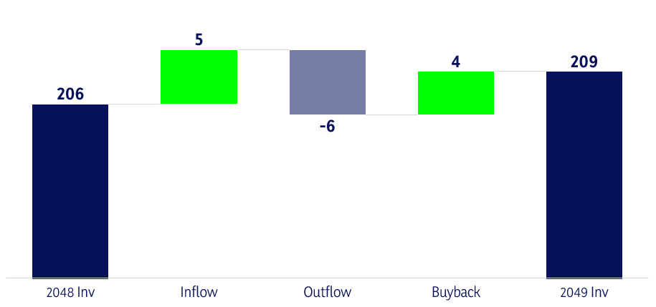
The 2049 closing inventory shows a net 3-ton gain over the previous fiscal year
1. Analyze the table → Decide on an initial chart type
2. Select appropriate data
3. Insert a chart (waterfall)
4. Use Axis Breaks to make the plot easy to read (Adjust axis, add icon)
5. Adjust the design
6. Build a title
215
210
205
Total Stock Volume [in Tons]
200
195
o
Inventory Cycle Factors [2048 - 2049]

Slide 11
The 2049 closing inventory shows a net 3-ton gain over the previous fiscal year
1. Analyze the table → Decide on an initial chart type
2. Select appropriate data
3. Insert a chart (waterfall)
4. Use Axis Breaks to make the plot easy to read (Adjust axis, add icon)
5. Adjust the design
6. Build a title
215
210
205
Total Stock Volume [in Tons]
200
195
o
Inventory Cycle Factors [2048 - 2049]

Slide 12
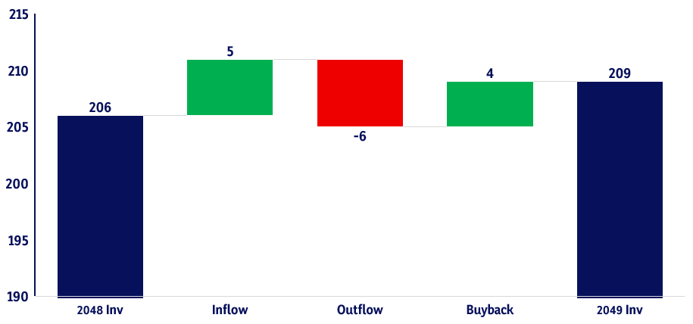
We reached the goal of 209 tonnes closing inventory in 2049, which is a net 3-ton gain over the previous fiscal year
1. Analyze the table → Decide on an initial chart type
2. Select appropriate data
3. Insert a chart (waterfall)
4. Use Axis Breaks to make the plot easy to read (Adjust axis, add icon)
5. Adjust the design
6. Build a title
0

Slide 13
1. Analyze the table → Decide on an initial chart type
2. Select appropriate data
3. Insert a chart (waterfall)
4. Use Axis Breaks to make the plot easy to read (Adjust axis, add icon)
5. Adjust the design
6. Build a title

